Slide 1
基於神經網絡的股市趨勢反轉點預測
Prediction of Stock Market Trend Reversal Points Based on Neural Networks

Slide 2
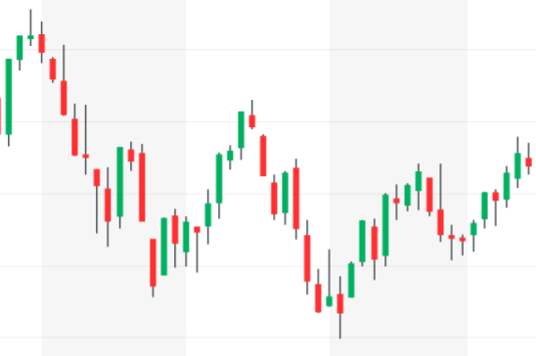
Introduction
This research aims to use neural networks to learn patterns in historical stock prices and technical analysis to predict whether trend reversal points will occur in the coming days.
Predict target:
Classify
A reversal(Peak) will occur in the future interval.
Features
in the history
Target interval
in the future
Predict target:
Predict
A reversal(Peak) will occur in the future interval.
Neural Network
Features

Slide 3



Flow chart of reversals prediction
Preprocess
2. Add features
3. Clean the dataset
1. Fetch the stock data
Peak
Date
Valley
Features
4. Split dataset with sliding windows
1
5. Normalization
6. Classification
0, No reversal occur;
1, A peak occurs;
2, A Valley occurs.
y =
0
Features
Target interval
Features
Target interval
7. Training and Infer
8. Evaluation
Date
Confusion metrics
Class
Training
Infer
Class
Class
Class
Features
X train
y train
model
y pred
y pred
y test

Slide 4
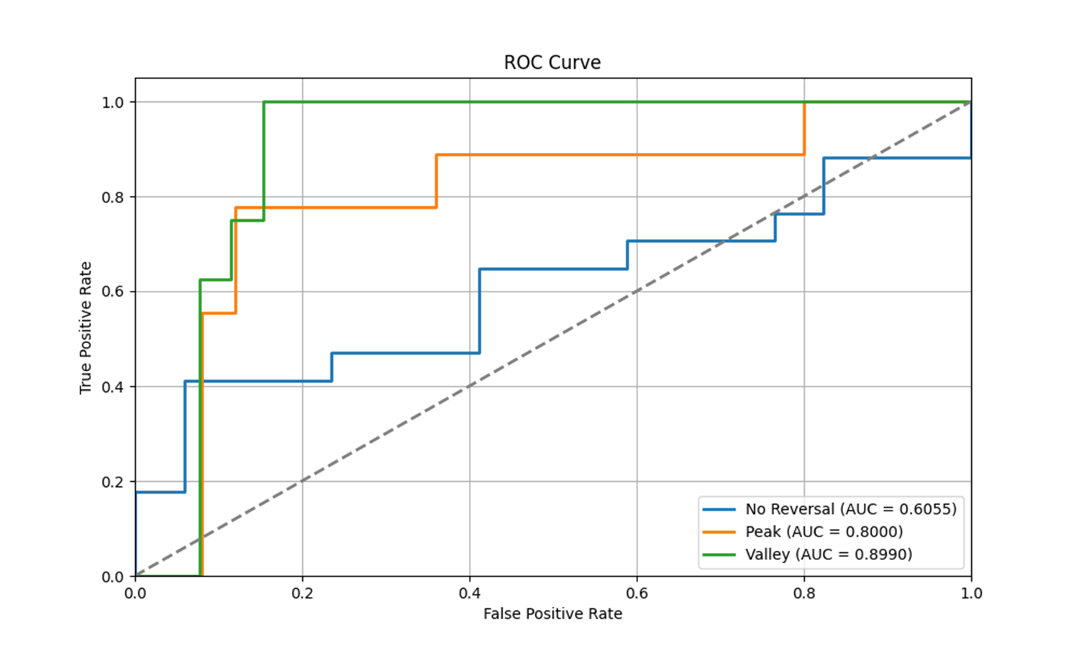
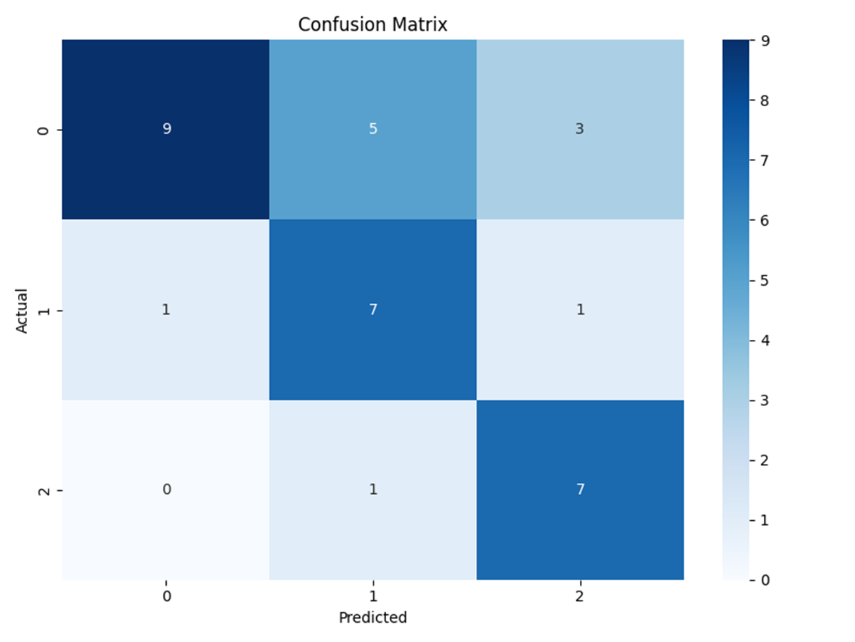
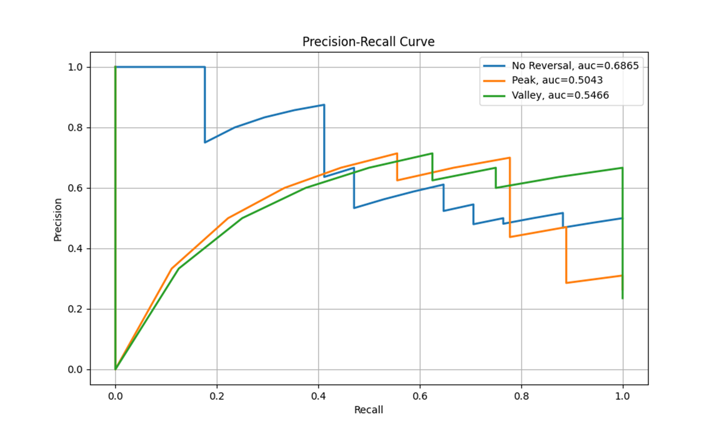
Evaluation tools
3. ROC, AUC
Matthews Correlation Coefficient (MCC) : 0.5472823290399778
Confusion Matrixes
4. PR, AUC
Class | Accuracy | Precision | Recall | F1-Score | Specificity | False Positive Rate | False Negative Rate
No Reversal | 0.676471 | 0.9 | 0.529412 | 0.666667 | 0.642857 | 0.357143 | 0.875
Peak | 0.676471 | 0.538462 | 0.777778 | 0.636364 | 0.642857 | 0.357143 | 0.875
Valley | 0.676471 | 0.636364 | 0.875 | 0.736842 | 0.642857 | 0.357143 | 0.875
Macro-average | 0.676471 | 0.691608 | 0.727397 | 0.679957 | 0.642857 | 0.357143 | 0.875
Micro-average | 0.676471 | 0.676471 | 0.676471 | 0.676471 | 0.642857 | 0.357143 | 0.875

